Slide 1
Hands on Data Bunga Iris
Kelompok 6

Slide 2
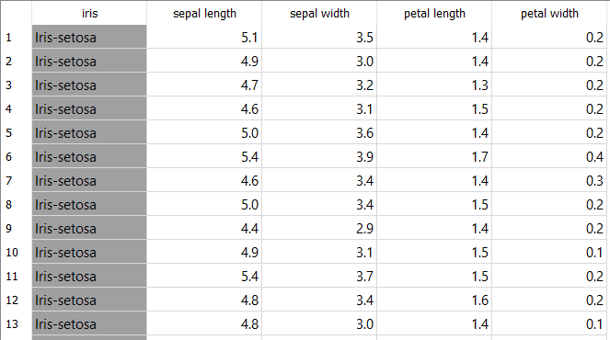
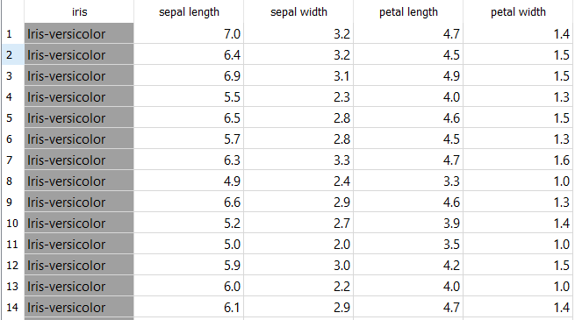
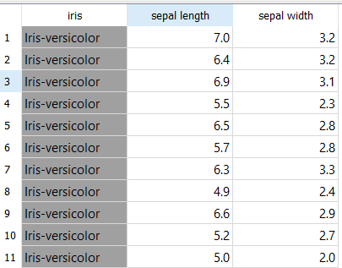
Observasi Data Table
Data Table : 150 rows
Data Table (1) : 50 rows
Data Table (2) : 50 rows && 2 features

Slide 3
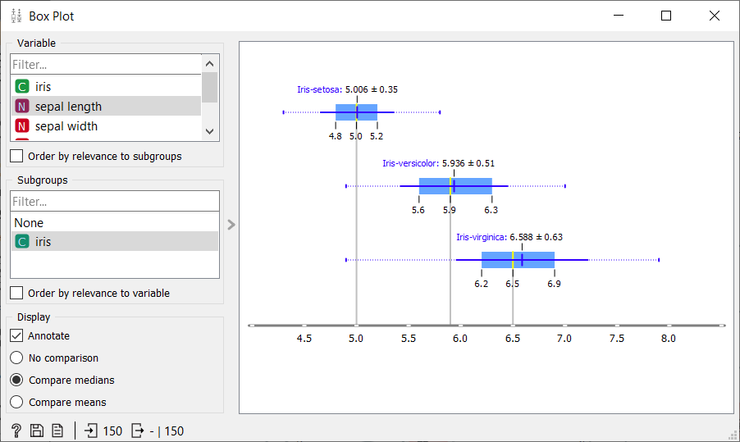
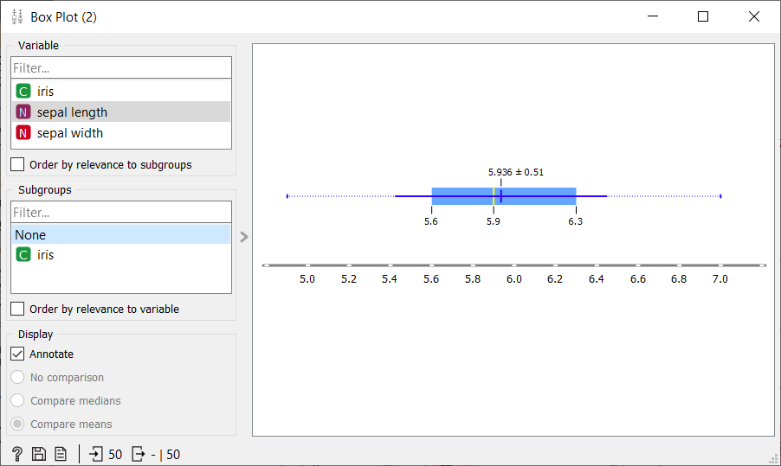
Observasi Visualize (Box Plot)
Box Plot
Box Plot (2)

Slide 4
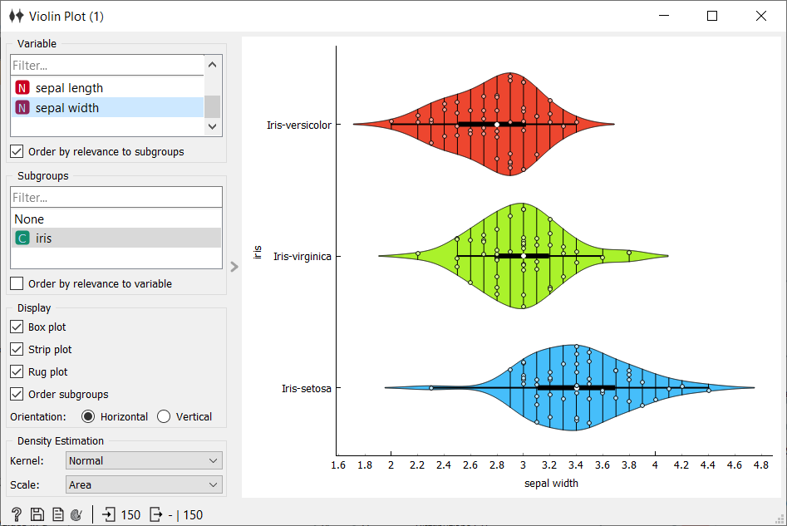
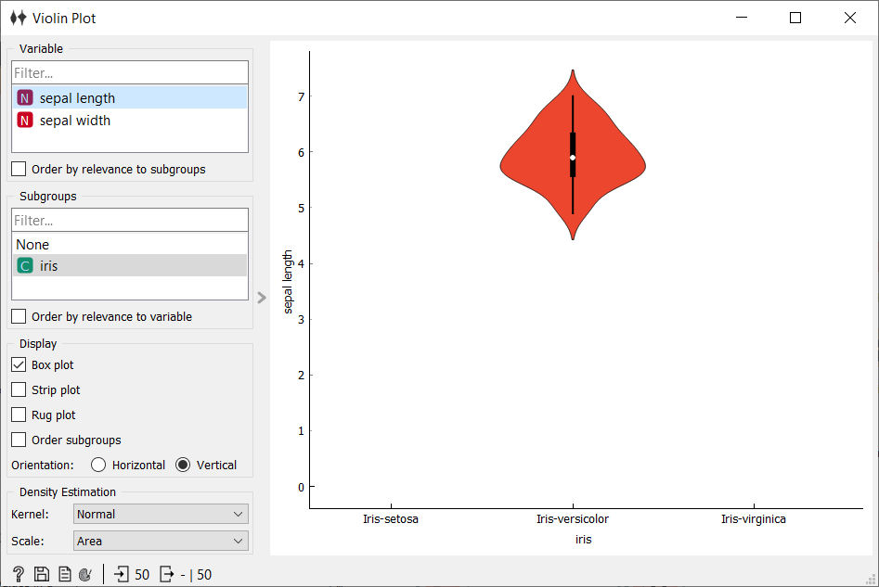
Observasi Visualize (Violin Plot)
Violoin Plot
Violin Plot (2)

Slide 5
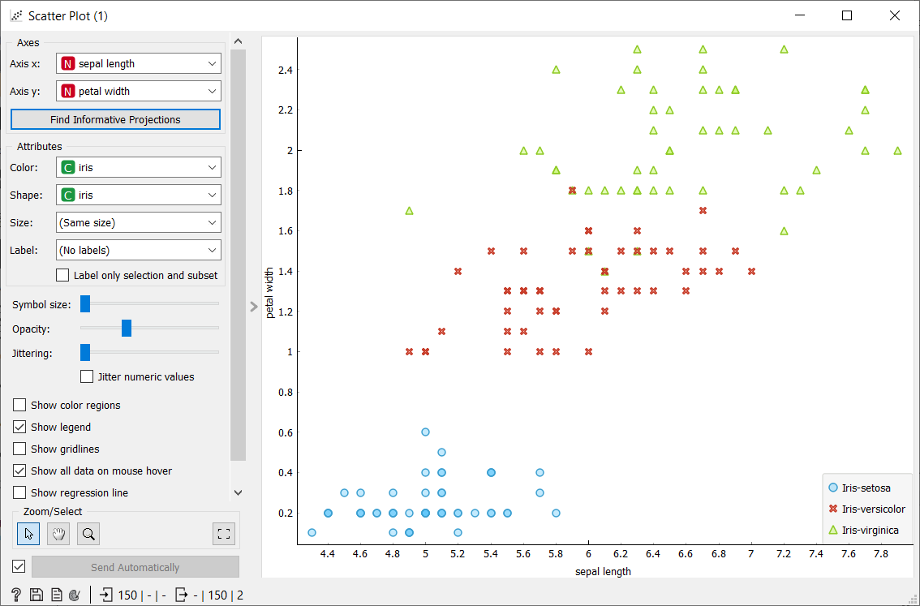
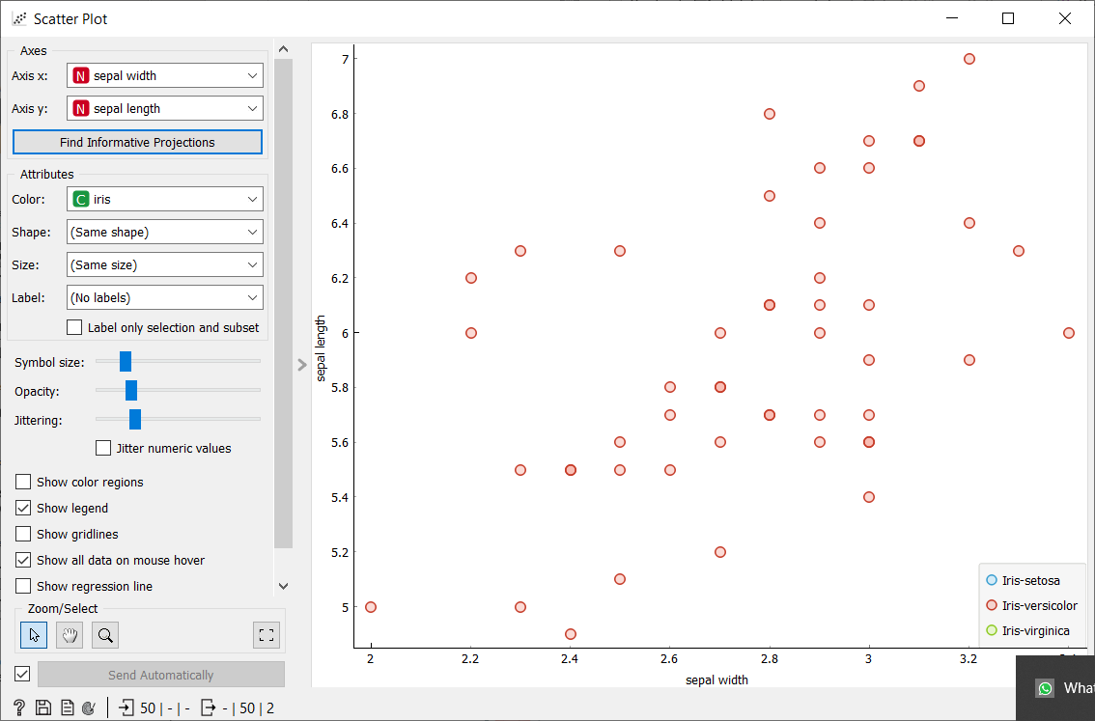
Observasi Visualize (Scatter Plot)
Violoin Plot
Scatter Plot (2)

Slide 6
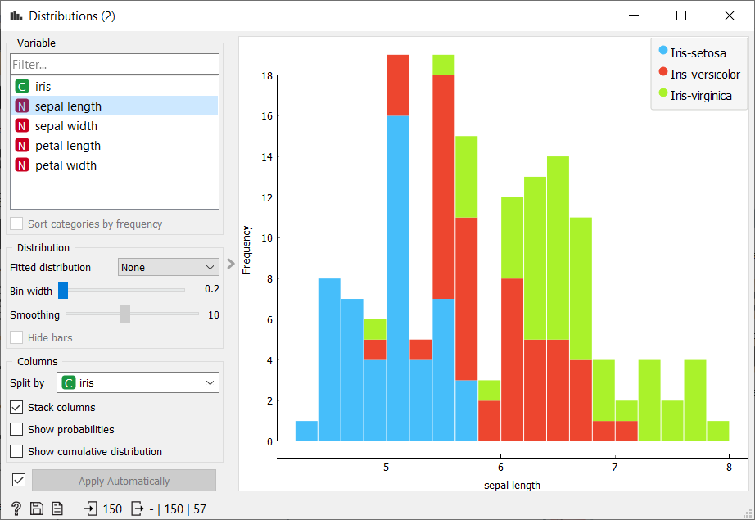
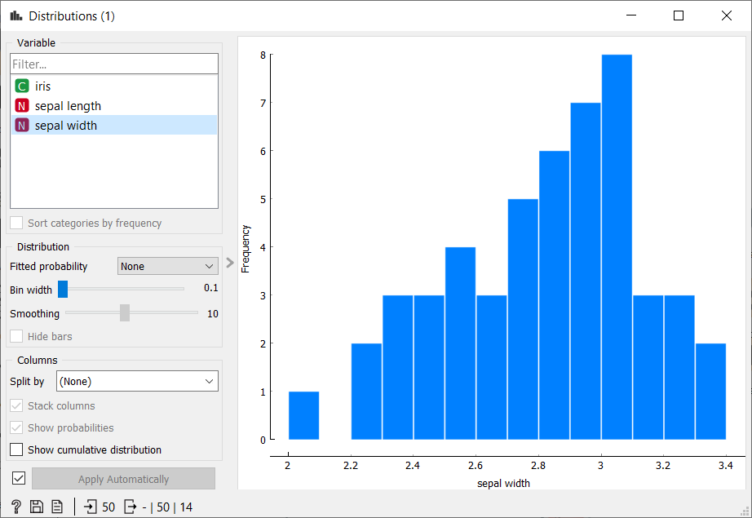
Observasi Visualize (Distribution)
Distribution
Distribution (2)

Slide 7
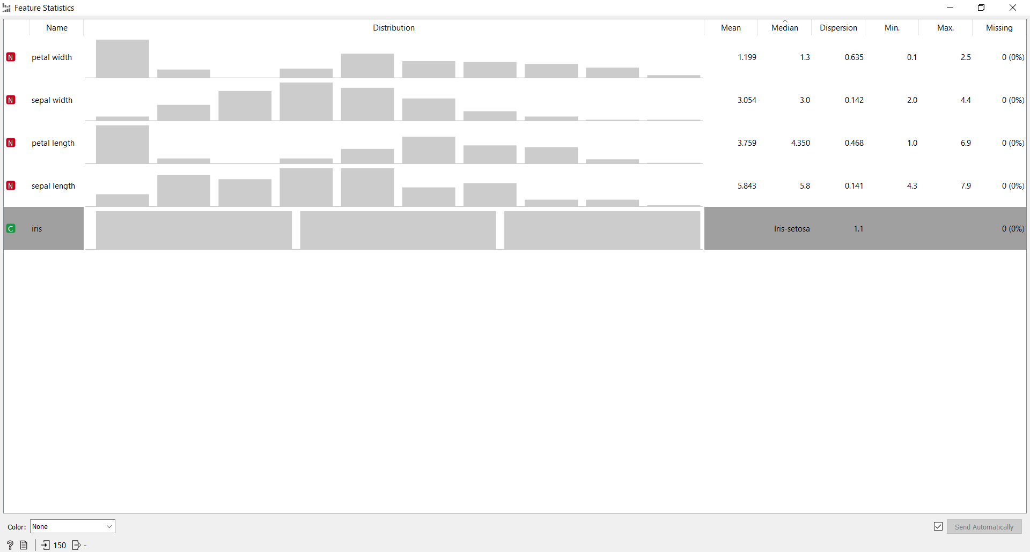
Observasi Visualize (Statisric Feature)

